Slide 1
INDIAN HISTORY AND CULTURE
B. A. 3rd Year (Annual System) SEC-5
CODE- SEC-3: HIST (A) 317

Slide 2
Environment and geography of India

Slide 3
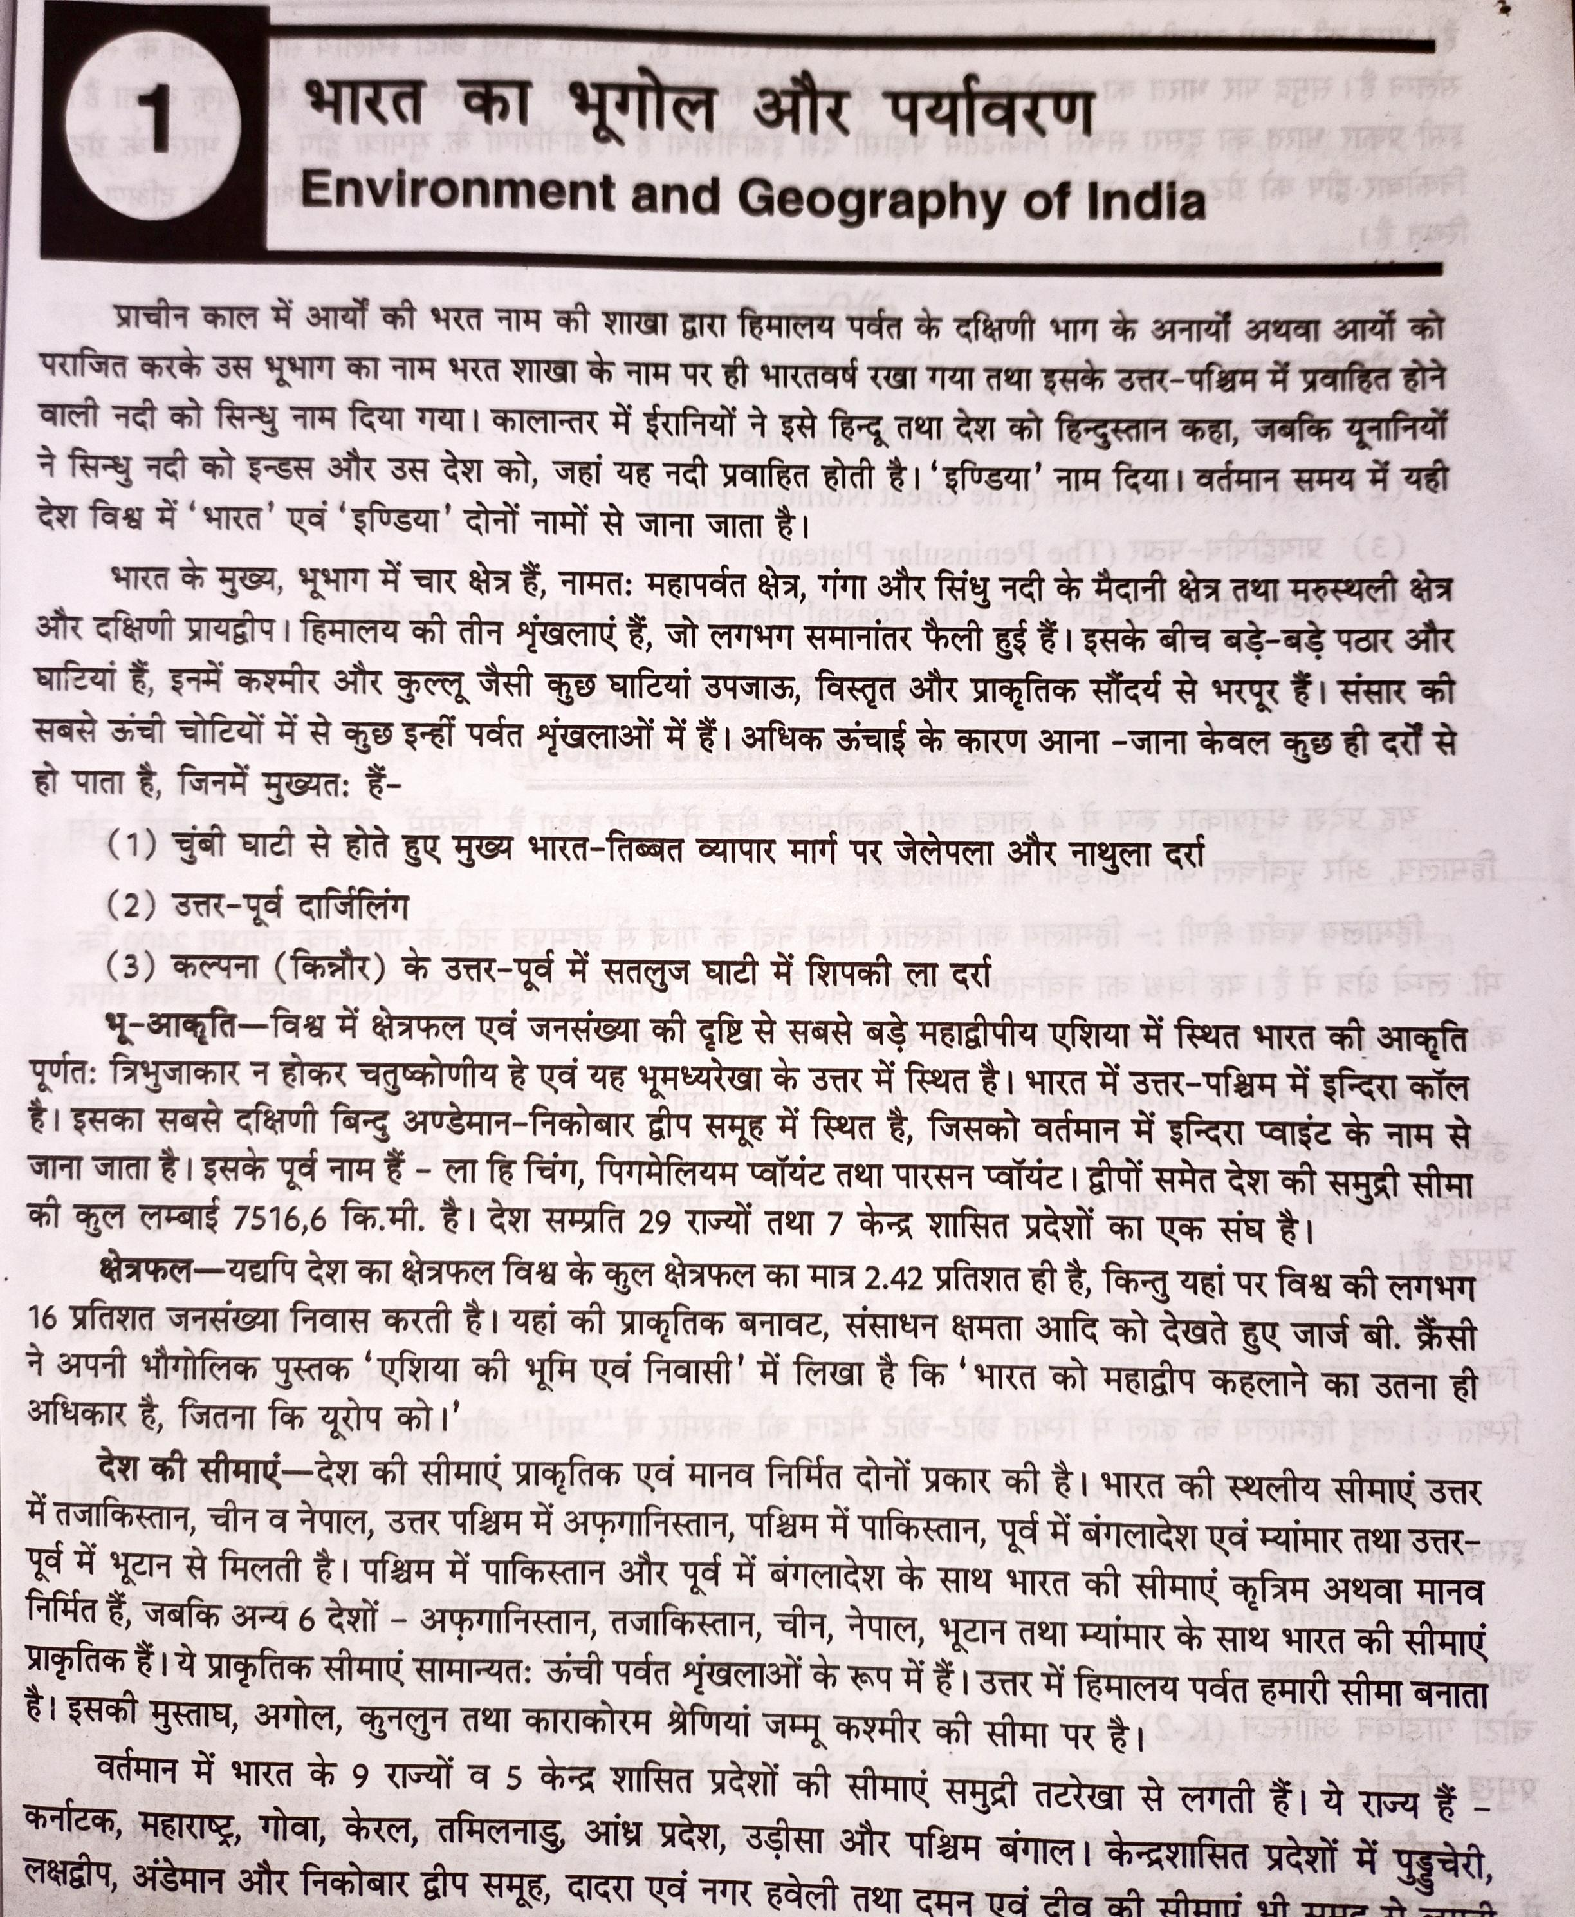

Slide 4
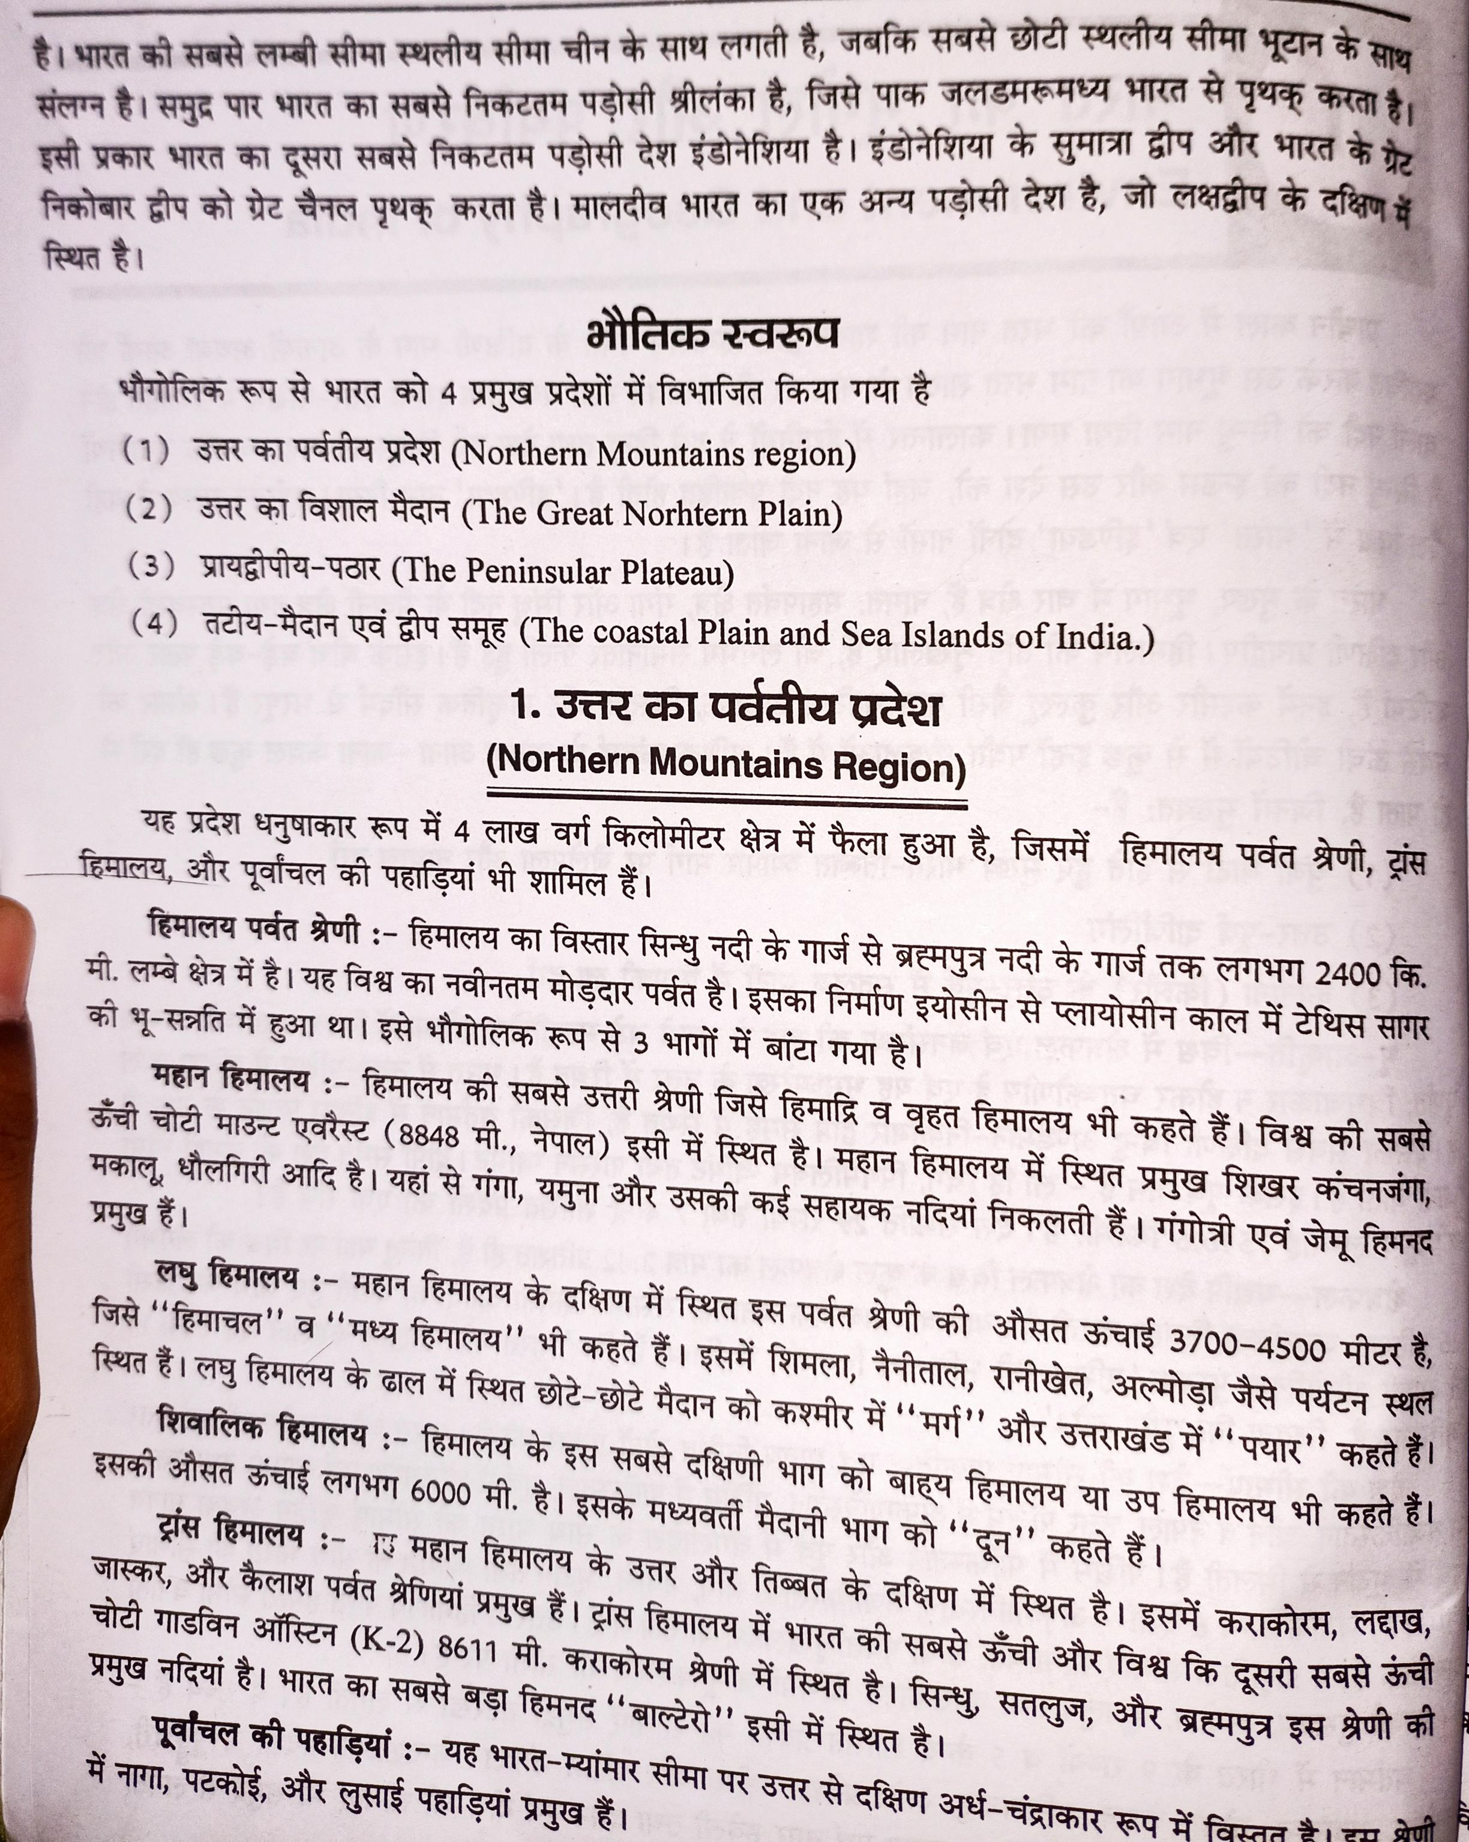

Slide 5
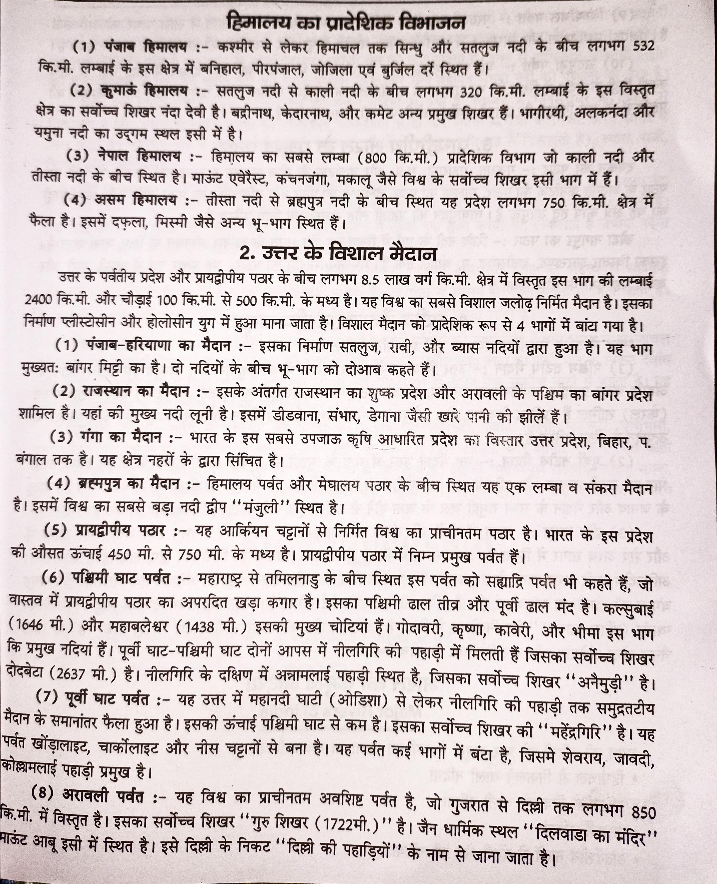

Slide 6
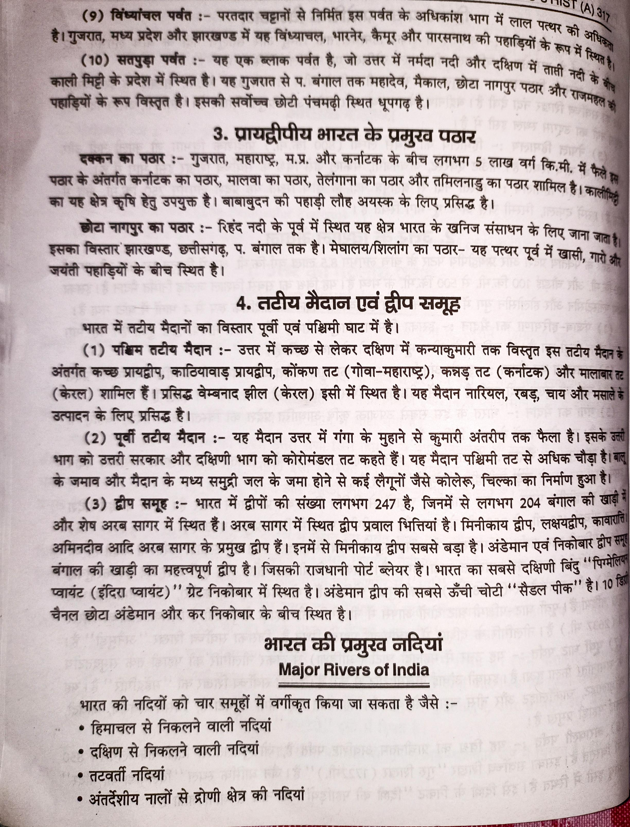

Slide 7
